Slide 1

The 49th ASTER Science Team Meeting OMP
GLIMS STAR 2017
June 5th 2018
Masaru Fujita
As of June 1st,2018
1
Notes:
SSSG report.
I am going to report the result of ASTER observation resource analysis.
This analysis was made the ASTER xar_database copied and built up on December 1, 2011.
The ASTER xar_database includes all ASTER observation request scheduling data.
I used to re-built up the ASTER copied xar_database once a month since till last June.
MAT-HP went out of control in July.
MAT-HP is six years old. Its parts were already out of stock last year.
Its operating system, HP-UNIX, and Sybase software got also out of support.
ASTER Instruments group halts ASTER GDS for an hour and creates ASTER xar database dump file once in a month.
ASTER xar database dump file is up loaded ftp site for US side to restore xar database and analyse scheduling data.

Slide 2
GLIMS STAR
GLIMS was renewed every year, 2015, 2016, 2017.
GLIMS STAR 2017 started on 2017/7/21
GLIMS STAR 2017 will continues till 2018/8/12.
The achievement of GLIMS 2017 reached to 64.1 % on 2018/6/1.
2
Notes:
D:\Work\ERSDAC\Daily\monitor\Category\GLIMS\2011\renew111027\GLIMS2011_scn_xar111201.xls
GLIMS STAR was originally planned by GLIMS Team and their parameters were modified by Leon-san.
GLIMS STAR aims to observe areas covered by snow and ice, they are regarded as cloud by GDS’s Cloud assessment. Then GLIMS STAR has no cloud limits.
2

Slide 3
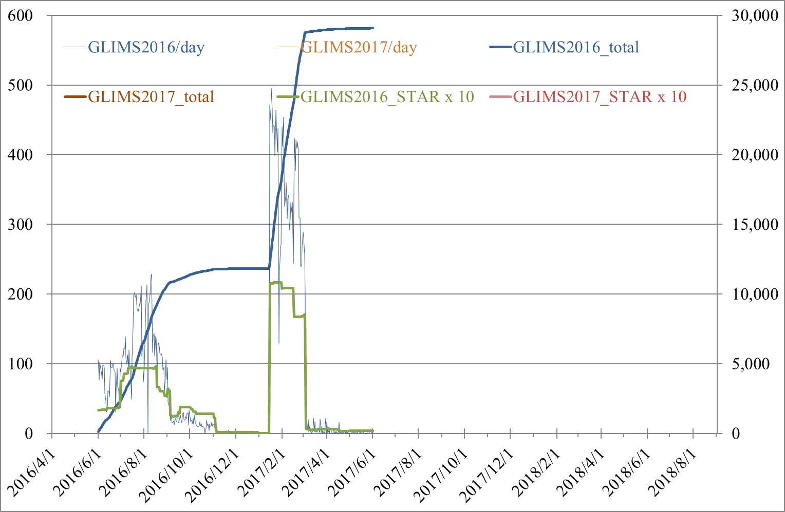
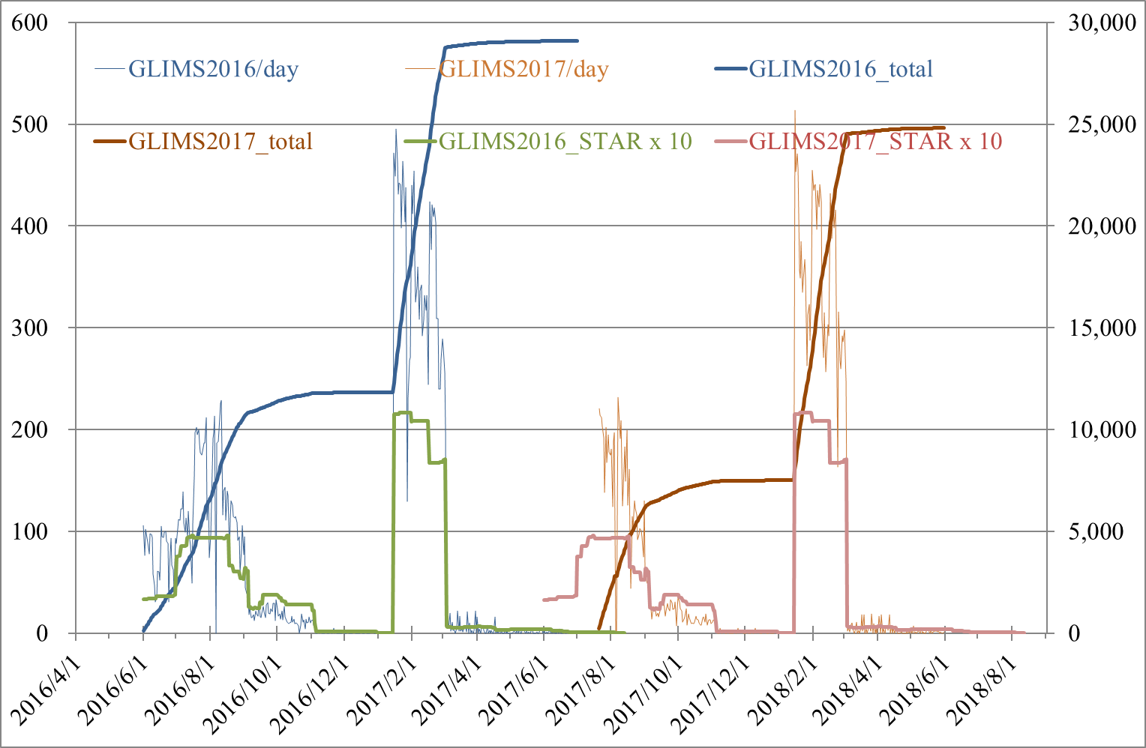
Observed Scenes of GLIMS 2016,2017
as of 2018/6/1
as of 2017/6/1
29,077
24,815
3
3
Notes:
3
D:\Work\ERSDAC\Daily\monitor\Category\GLIMS\2010\GLIMS_2010.xls
3

Slide 4
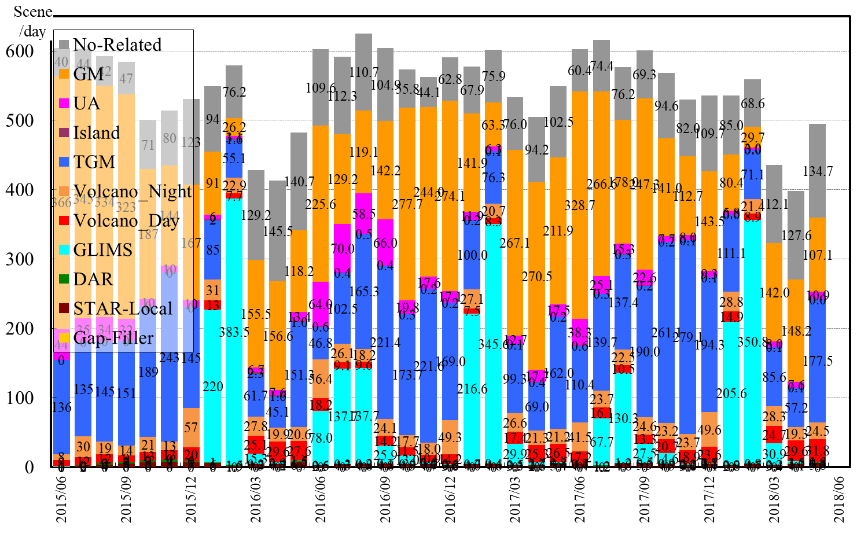
ASTER Observation Resource Analysis
GM6’s summer observation started on June 1st.
GM7’s observation started on October 1st.
As of Jun 1st, 2018
1/21 4/8
Japan-US ASTER Meeting - February 9-11, 2016
NASA Goddard Space Flight Center, Greenbelt, Md. U.S.A
Notes:
GM (orange), TGM (blue), GLIMS (light blue) have many observation scenes and are seasonally fluctuating.
In general, the number of scenes is small in UA (magenta), Island Star (dark red), Volcano Night & Day (Orange & Red), DAR (Green), STAR Local (Brown).
When newly issued, or when GM, TGM, GLIMS are saturated and the priority drops, the number of scenes for UA, Island Star, Volcano Night & Day, DAR, STAR Local, Gap Filler increase.
GLIMS scenes decreased while GM and TGM increased in September.

Slide 5
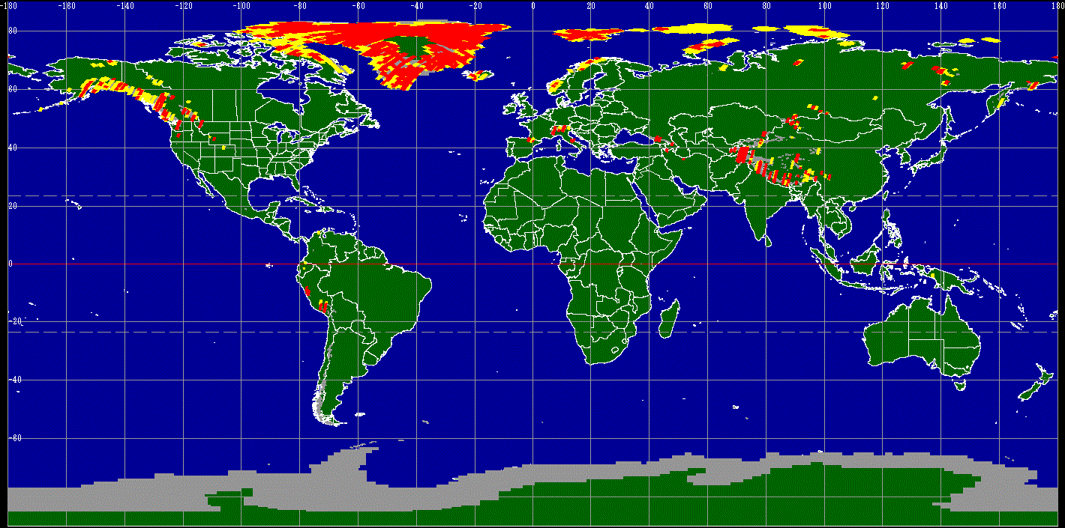
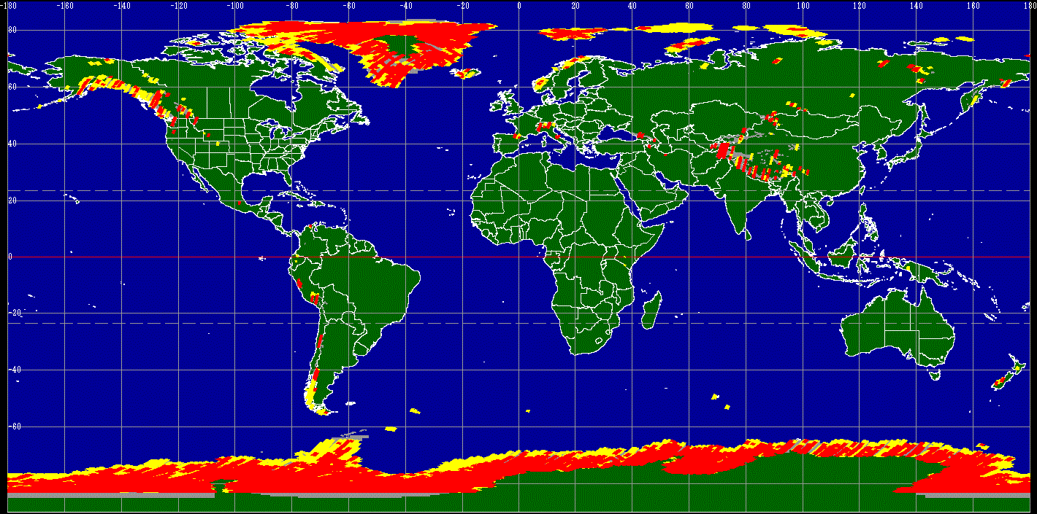
AOI and Observed Scenes of GLIMS 2017
as of Dec 1st, 2017
as of June 1st, 2018
Dec 01, 2017
■: <20% cloud 2,136 scenes ■:Product 7,477 scenes
■：Scheduled 7,483 scenes
■：AOI
June 01, 2018
8,836 scenes
24,642 scenes
24,815 scenes
5
Notes:
This slide shows AOI Map and Obseved scene Map of GLIMS2011.
Gray area shows AOI. Yellow Green Area shows scheduled scenes. Yellow area shows L1A product.
Most of observed scenes exist in the northern hemisphere.
GLIMS2001 had not yet observed Antarctica.
5

Slide 6
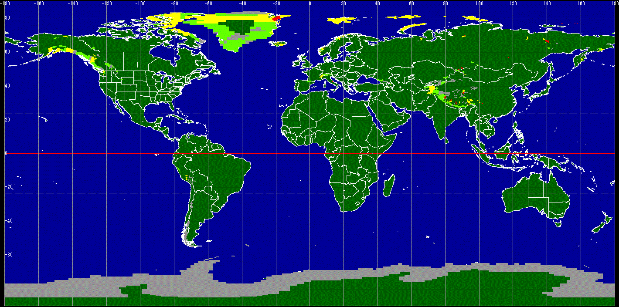

Achievement Map of GLIMS 2017
June 1st, 2018
as of Dec 01, 2017
Achievement 11.7% Dec 01, 2017
■ < 20% =< ■ < 50% =< ■ < 80% =< ■
→ 64.1% June 01, 2018
6
Notes:
This slide shows AOI Map and Obseved scene Map of GLIMS2011.
Gray area shows AOI. Yellow Green Area shows scheduled scenes. Yellow area shows L1A product.
Most of observed scenes exist in the northern hemisphere.
GLIMS2001 had not yet observed Antarctica.
6

Slide 7
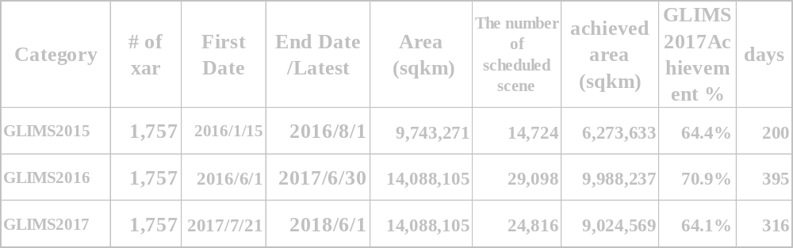
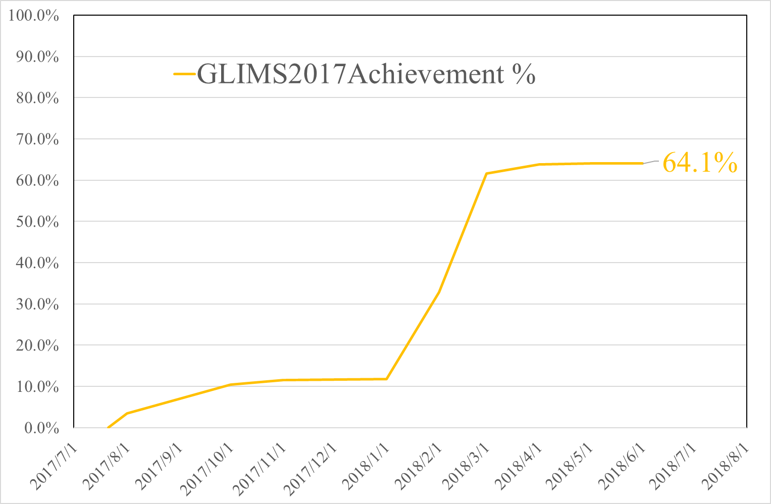
Summary of GLIMS 2015 - 2017
7

Slide 8
GLIMS STAR
GLIMS was renewed every year, 2015, 2016, 2017.
GLIMS STAR 2017 started on 2017/7/21
GLIMS STAR 2017 will continues till 2018/8/12.
The achievement of GLIMS 2017 reached to 64.1 % on 2018/6/1.
Shall we continue GLIMS 2017 or start new GLIMS 2018?
8
Notes:
D:\Work\ERSDAC\Daily\monitor\Category\GLIMS\2011\renew111027\GLIMS2011_scn_xar111201.xls
GLIMS STAR was originally planned by GLIMS Team and their parameters were modified by Leon-san.
GLIMS STAR aims to observe areas covered by snow and ice, they are regarded as cloud by GDS’s Cloud assessment. Then GLIMS STAR has no cloud limits.
8

Slide 9
Thank you for attention!
Masaru Fujita
J-spacesystems

Slide 10
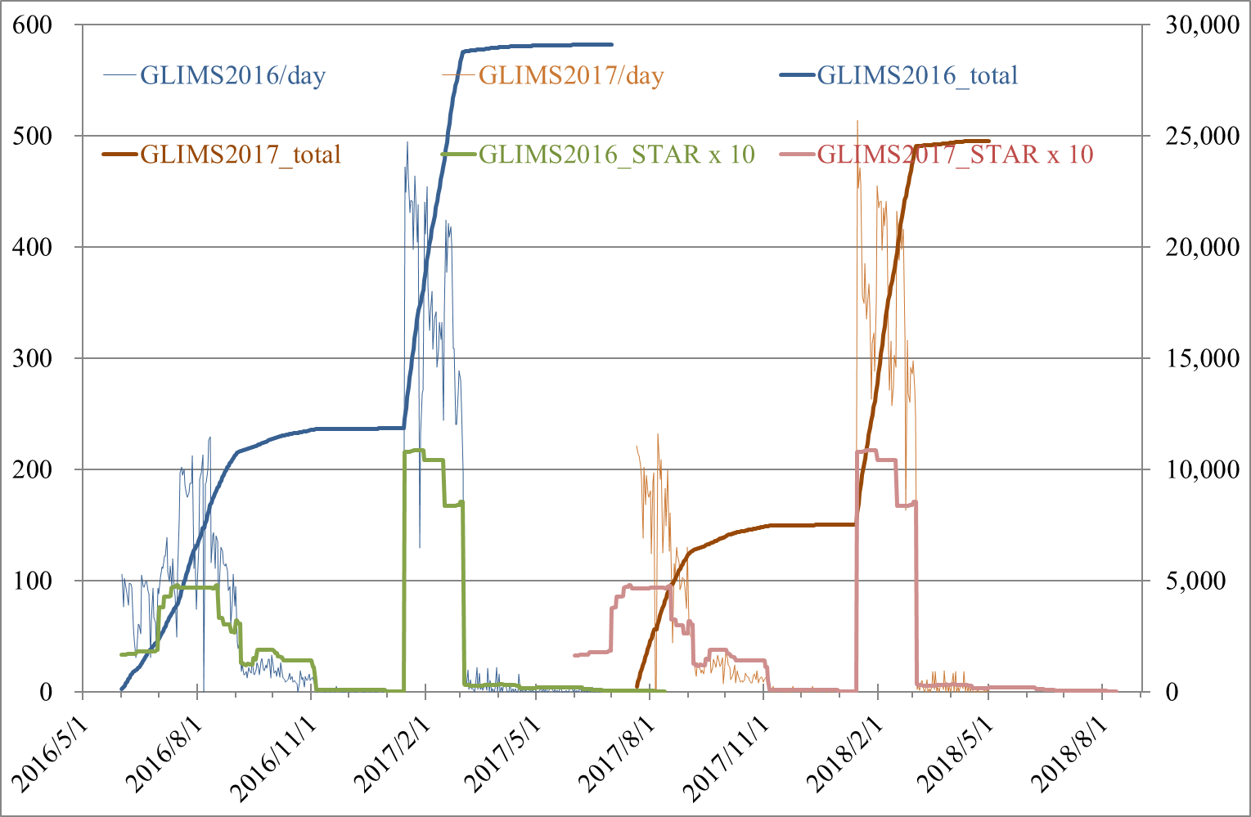
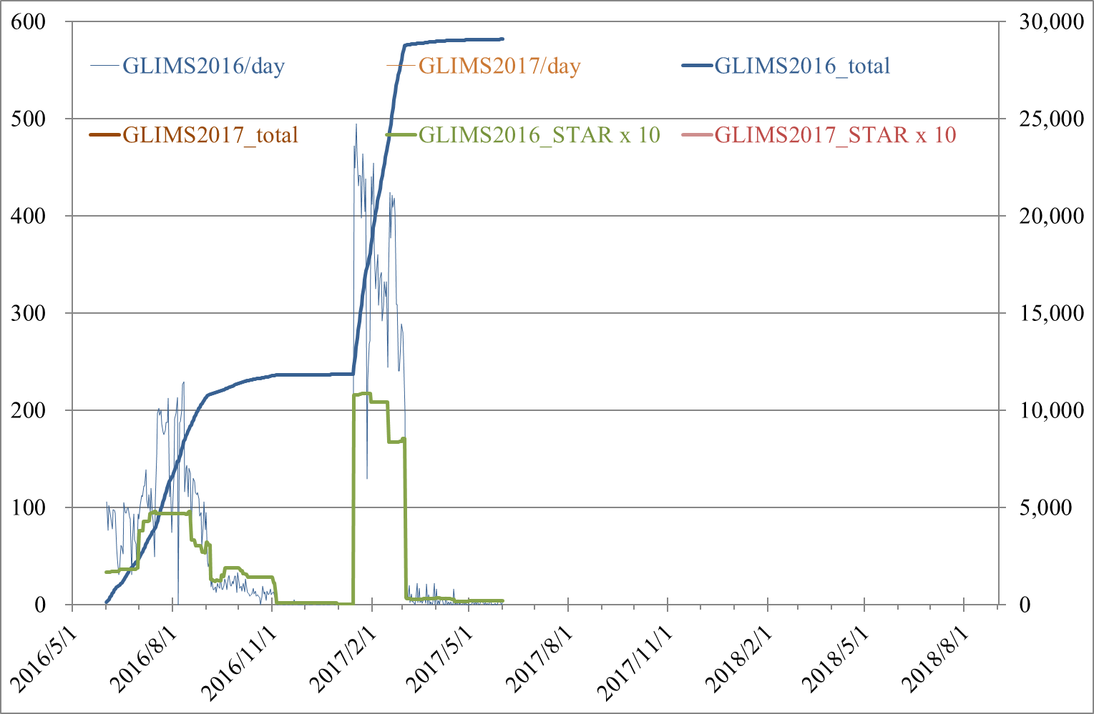
Observed Scenes of GLIMS 2016,2017
as of 2017/6/1
as of 2018/5/1
29,077
24,771
10
10
Notes:
10
D:\Work\ERSDAC\Daily\monitor\Category\GLIMS\2010\GLIMS_2010.xls
10

Slide 11
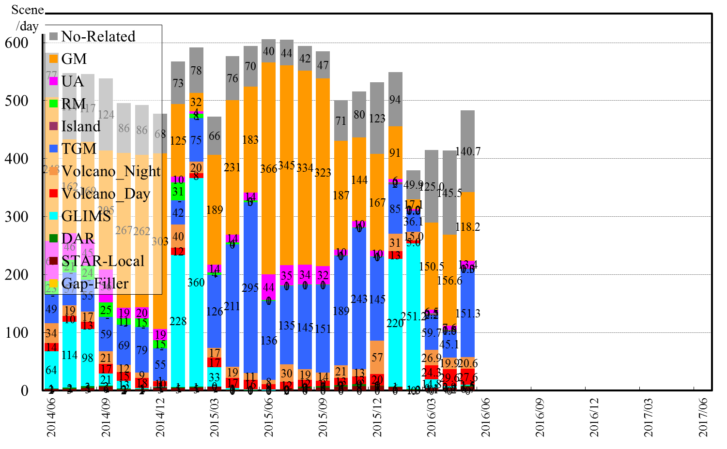
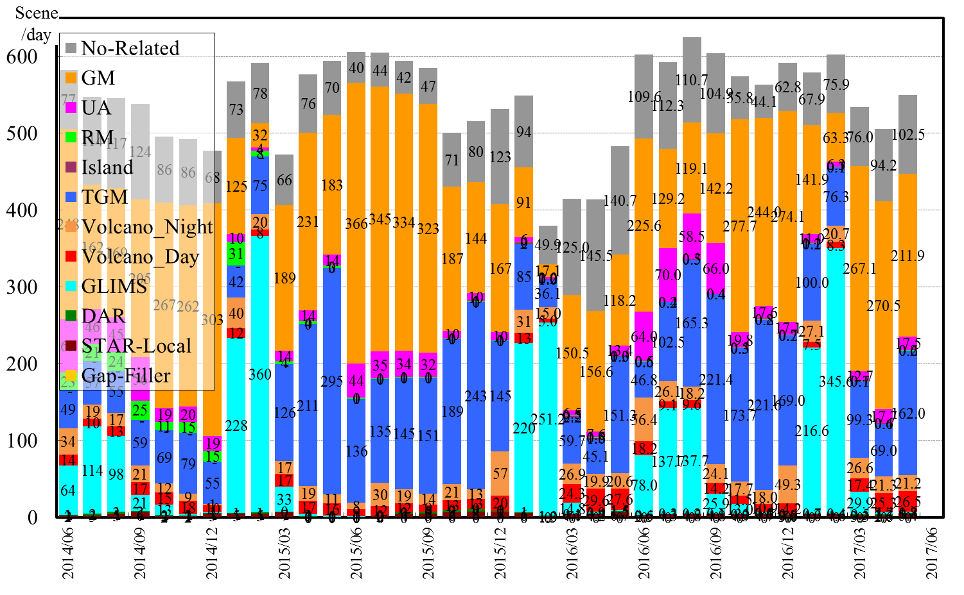
ASTER Observation Resource Analysis
GM6’s summer observation started on June 1st.
GM7 started on Oct 1st,2016.
1/21 4/8
TGM7_{May to October} started on May 1st
Notes:
1/21-4/8:
Cloud coverage prediction data ,TCC (Total Cloud Cover) was replaced by mistake.
GLIMS had not been affected by TCC error because GLIMS were free from cloud parameter.
GLIMS2015 was not proposed.

Slide 12
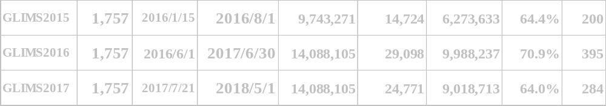
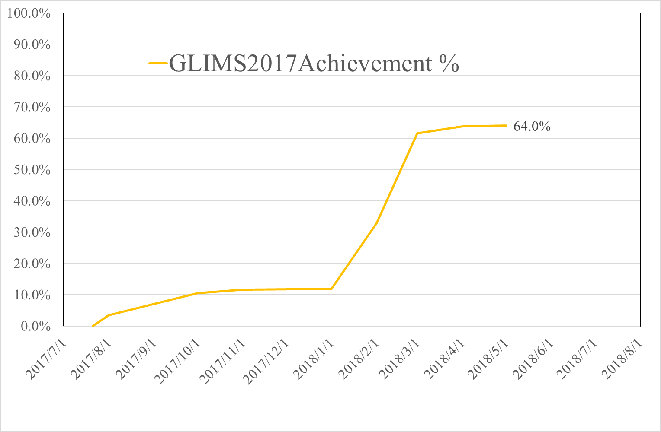
Summary of GLIMS 2015 - 2017
12

